Slide 1
Part 2. Data Management

Slide 2
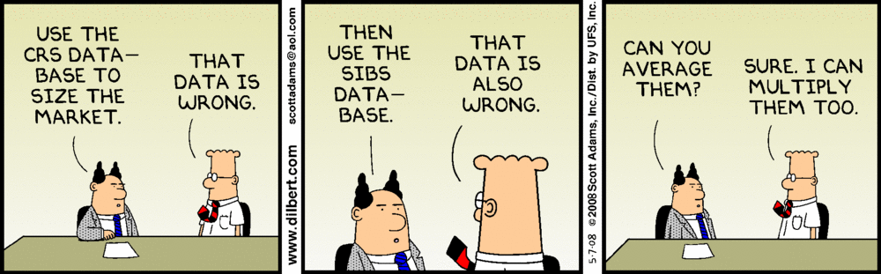

Slide 3
Creating a Dataset

Slide 4
Topics
R data structures
vectors, matrices, arrays, data frames, factors, lists
Data Input
text file Excel Stat packages (SAS, SPSS, Stata) DBMS

Slide 5
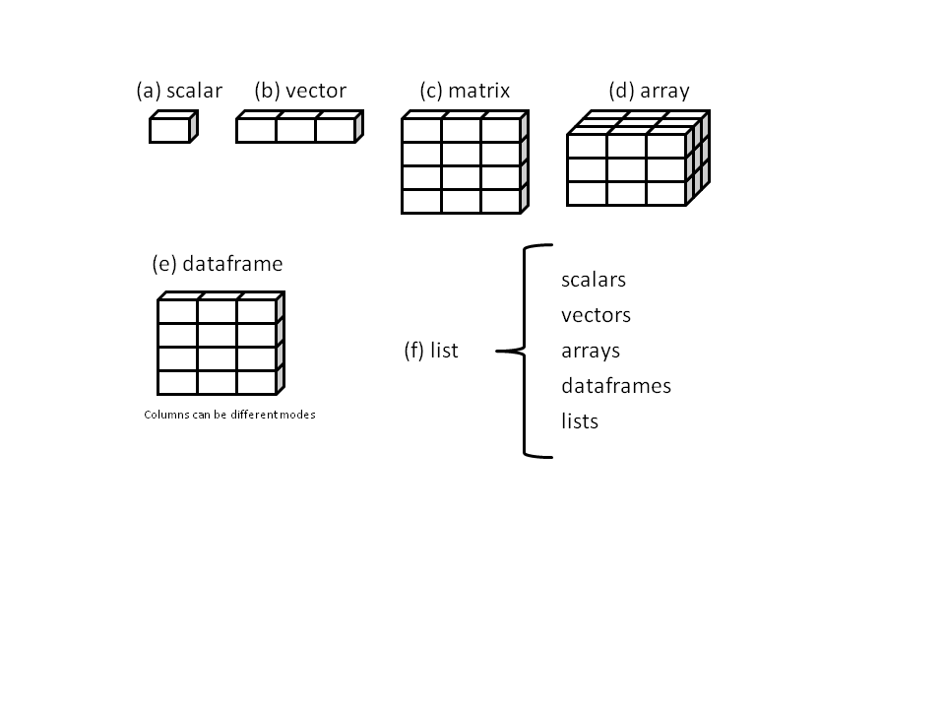
R Data Structures

Slide 6
Vectors
One dimensional arrays
a <- c(1, 2, 5, 3, 6, -2, 4)
b <- c("one", "two", "three")
c <- c(TRUE, TRUE, TRUE, FALSE, TRUE, FALSE)

Slide 7
Vectors(2)
Identifying elements
a <- c(1, 2, 5, 3, 6, -2, 4)
a[3]
[1] 5
a[c(1, 3, 5)]
[1] 1 5 6
a[2:6]
[1] 2 5 3 6 -2

Slide 8
Matrices
Two dimensional arrays where each element has same mode (numeric, character, or logical)
[,1] [,2] [,3] [,4]
[1,] 1 6 11 16
[2,] 2 7 12 17
[3,] 3 8 13 18
[4,] 4 9 14 19
[5,] 5 10 15 20

Slide 9
Creating a Matrix
y <- matrix(1:20, nrow=5)
y
[,1] [,2] [,3] [,4]
[1,] 1 6 11 16
[2,] 2 7 12 17
[3,] 3 8 13 18
[4,] 4 9 14 19
[5,] 5 10 15 20
ncol=4 would work too

Slide 10
Creating a Matrix
y <- matrix(1:20, nrow=5, byrow=TRUE)
y
[,1] [,2] [,3] [,4]
[1,] 1 2 3 4
[2,] 5 6 7 8
[3,] 9 10 11 12
[4,] 13 14 15 16
[5,] 17 18 19 20

Slide 11
Creating a Matrix
data <- c(3615, 365, 2212, 3624, 6315, 4530)
rnames <- c("Alabama", "Alaska", "Arizona")
cnames <- c("Population", "Income")
y <- matrix(data, ncol=2, dimnames=list(rnames, cnames))
Population Income
Alabama 3615 3624
Alaska 365 6315
Arizona 2212 4530

Slide 12
Using Matrix Subscripts
x <- matrix(1:10, nrow = 2)
x
[,1] [,2] [,3] [,4] [,5]
[1,] 1 3 5 7 9
[2,] 2 4 6 8 10
x[2, ]
[1] 2 4 6 8 10
x[, 2]
[1] 3 4 x[1, 4]
[1] 7 x[1, c(4, 5)]
[1] 7 9

Slide 13
Data frame
Rectangular array of data
More general than a matrix - different columns can contain different modes of data (numeric, character, etc.)
Similar to datasets in SAS, SPSS, and Stata
mydata <- data.frame( col1, col2, …, coln)

Slide 14
Creating a data frame
ptID <- c(111, 208, 113, 408)
age <- c(25, 34, 28, 52)
diabetes <- c("Type1", "Type2", "Type1", "Type1")
status <- c("Poor", "Improved", "Excellent", "Poor")
ptdata <- data.frame(ptID, age, diabetes, status)
ptdata
ptID age diabetes status
1 111 25 Type1 Poor
2 208 34 Type2 Improved
3 113 28 Type1 Excellent
4 408 52 Type1 Poor

Slide 15
Specifying elements of a data frame
ptdata[1:2]
ptID age
1 111 25
2 208 34
3 113 28
4 408 52
ptdata[c("diabetes","status")]
diabetes status
1 Type1 Poor
2 Type2 Improved
3 Type1 Excellent
4 Type1 Poor
ptdata$age
[1] 25 34 28 52

Slide 16
Specifying elements of a data frame
ptdata[1:2]
ptID age
1 111 25
2 208 34
3 113 28
408 52
ptdata[2:3, 1:2]
ptID age
2 208 34
113 28
ptdata[c(1,3), 1:2]
ptID age
1 111 25
3 113 28

Slide 17
With
summary(mtcars$mpg)
plot(mtcars$mpg, mtcars$disp)
with(mtcars, {
summary(mpg)
plot(mpg, disp)
})

Slide 18
Factors
Data structure specifying categorical (nominal) or ordered categorical (ordinal) variables
Tells R how to handle that variable in analyses
Very important and misunderstood
Any variable that is categorical or ordinal should usually be stored as a factor.

Slide 19
Factors (2)
ptdata$sex <- c(1, 1, 2, 5)
ptdata$sex <- factor(sex, levels=c(1, 2),
labels=c("Male", "Female"))
associates 1=Male, 2=Female
Treats sex as a categorical variable in all analyses
What happens to sex=5?

Slide 20
Factors (2)
ptdata$status <- c(1, 2, 3, 1)
ptdata$status <- factor(ptdata$status, ordered=TRUE,
levels=c(1, 2, 3)
levels=c("Poor", "Improved", "Excellent")
associates 1=Poor, 2=Improved, 3=Excellent Treats status as an ordinal variable in all analyses

Slide 21
Lists
Ordered collection of objects (components)
Many important functions return lists
mylist <- list(name1=object1, name2=object2, …)

Slide 22
List Example
mylist
g <- "My First List"
h <- c(25, 26, 18, 39)
j <- matrix(1:10, nrow = 5)
k <- c("one", "two", "three")
mylist <- list(title = g,
ages = h,
mymatrix = j,
mystrings = k)
$title
[1] "My First List"
$ages
[1] 25 26 18 39
$mymatrix
[,1] [,2]
[1,] 1 6
[2,] 2 7
[3,] 3 8
[4,] 4 9
[5,] 5 10
$mystrings
[1] "one" "two" "three"

Slide 23
List Example
mylist
mylist[[2]]
[1] 25 26 18 39
mylist[["ages"]]
[1] 25 26 18 39
mylist$ages
[1] 25 26 18 39
$title
[1] "My First List"
$ages
[1] 25 26 18 39
$mymatrix
[,1] [,2]
[1,] 1 6
[2,] 2 7
[3,] 3 8
[4,] 4 9
[5,] 5 10
$mystrings
[1] "one" "two" "three"

Slide 24
List Example
mylist
mylist$ages[2]
[1] 26
mylist[[2]][2]
[1] 26
mylist$mymatrix[2,2]
[1] 7
mylist[[3]][,2]
[1] 6 7 8 9 10
$title
[1] "My First List"
$ages
[1] 25 26 18 39
$mymatrix
[,1] [,2]
[1,] 1 6
[2,] 2 7
[3,] 3 8
[4,] 4 9
[5,] 5 10
$mystrings
[1] "one" "two" "three"

Slide 25
Data Input

Slide 26
Import from Delimited Text File
First row are variable names
library(readr)
# comma separated values
mydataframe <- read_csv("file")
# tab separated values
mydataframe <- read_tsv("file")
# semicolon separated values
mydataframe <- read_csv2("file")

Slide 27
Import from Delimited Text File
library(readr)
# more control over reading file
mydataframe <- read_delim("file",
delim,
col_names = TRUE,
na = c("", "NA"),
skip = 0,
n_max = Inf)

Slide 28
Importing from Excel
# install.packages(readxl)
library(readxl)
df <- read_excel("myfile.xlsx", 1)

Slide 29
Importing from Stat Packages
# install.packages(haven)
library(haven)
# sas
df <- read_sas("myfile.sas7bdat")
# spss
df <- read_sav("myfile.sav")
# stata
df <- read_stata("myfile.dta")

Slide 30
Accessing DBMS
R can access MS SQL Server, MS Access, MySQL, Oracle, PostgreSQL, DB2, Sybase, Teradata, SQLite, …
One of the best ways to deal with large datasets

Slide 31
Functions for working with objects
Function | Action
length(object) | number of elements/components
dim(object) | dimensions of an object
str(object) | structure of an object
class(object) | class or type of an object
names(object) | names of components in an object
c(object, object,...) | combines objects into a vector
cbind(object, object, ...) | combines objects as columns
rbind(object, object, ...) | combines objects as rows
object | prints the object
head(object) | list the first part of the object
tail(object) | list the last part of the object
rm(object) | delete an object

Slide 32
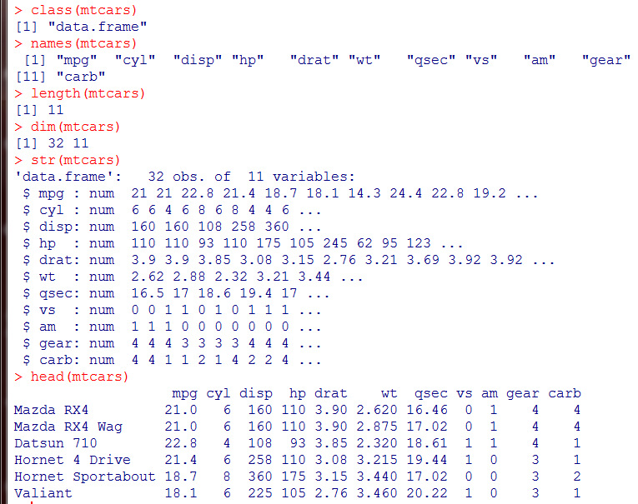

Slide 33
Note for programmers
The period (.) has no special significance in object names. However, the dollar sign ($) has a somewhat analogous meaning, identifying the parts of an object. For example, A$x refers to variable x in data frame A.
R does not provide for multi-line or block comments. You must start each line of a multi-line comment with #. For debugging purposes, you can also surround code that you want the interpreter to ignore with the statement if(0){…}.
R does not have scalar values. Scalars are represented as one element vectors.

Slide 34
Note for programmers
Variables cannot be declared. They come into existence on first assignment.
Assigning a value to a non-existent element of a vector, matrix, array, or list will expand that structure to accommodate the new value.
x <- c(2, 6, 4)
x[7] <- 10
x
[1] 2 6 4 NA NA NA 10
The vector x has expanded from 3 elements to 7 elements through the assignment.
x <- x[1:3] would shrink it back to three elements again.
Indices in R start at 1, not at zero. In the vector above, x[1] is 2.

Slide 35
Data management

Slide 36
Topics
arithmetic and logical operators
creating, recoding, renaming variables
missing values and data values
type conversions
sorting, merging, subsetting
reshaping datasets

Slide 37
Arithmetic Operators
Operator | Description
+ | Addition
- | Subtraction
* | Multiplication
/ | Division
^ or ** | Exponentiation

Slide 38
Logical Operators
Operator | Description
< | Less than
<= | Less than or equal to
> | Greater than
>= | Greater than or equal to
== | Exactly equal to
!= | Not equal to
!x | Not x
x | y | x or y
x & y | x and y

Slide 39
Salaries dataset
data(Salaries, package="car")
names(Salaries)
[1] "rank" "discipline" "yrs.since.phd" "yrs.service"
[5] "sex" "salary"
head(Salaries)
rank discipline yrs.since.phd yrs.service sex salary
1 Prof B 19 18 Male 139750
2 Prof B 20 16 Male 173200
3 AsstProf B 4 3 Male 79750
4 Prof B 45 39 Male 115000
5 Prof B 40 41 Male 141500
6 AssocProf B 6 6 Male 97000

Slide 40
Add new variables to a data frame
experience <- (yrs.since.phd + yrs.service)/2 # fails
experience <- (Salaries$yrs.since.phd + Salariesyrs.service)/2 # doesn't fail but…
Salaries$experience <- (Salaries$yrs.since.phd + Salaries$yrs.service)/2 # works
Salaries <- transform(Salaries, experience = (yrs.since.phd + yrs.service )/2) # better

Slide 41
Using the transform() function
Salaries <- transform(Salaries,
logSalary = log(salary), experience = ( yrs.since.phd + yrs.service)/2,
discipline = factor(discipline, levels=c("A", "B"),
labels=c("Theoretical", "Applied")),
salaryCat = cut(salary,
quantile(salary, probs=c(0, .33, .66, 1)),
labels=c("low", "med", "high"))
)

Slide 42
Renaming variables in a data frame
names(Salaries)
[1] "rank" "discipline" "yrs.since.phd" "yrs.service"
[5] "sex" "salary"
names(Salaries)[3:4] <- c("yrs.post.phd", "yrs.of.service")
names(Salaries)
[1] "rank" "discipline" "yrs.post.phd" yrs.of.service"
[5] "sex" "salary"

Slide 43
Missing values
coded as NA (no quotation marks)
test with is.na()
x == NA doesn't work

Slide 44
Working with missing values
data(sleep, package="VIM")
head(sleep)
head(is.na(sleep)
colSums(is.na(sleep))
colMeans(is.na(sleep))
newSleep <- na.omit(sleep)

Slide 45
Recoding to missing values
hypothetical example
df$age <- ifelse(df$age == 99, NA, df$age)
df$age <- ifelse(df$age %in% c(99, 999, -1), NA, df$age)
delete all missing values newdf <- na.omit(df) # listwise deletion

Slide 46
Sorting data frames
index <- order(Salaries$rank, Salaries$salary)
Salaries <- Salaries[index, ]
order() returns a permutation which rearranges its argument into ascending or descending order
default is ascending (reverse with - sign)
note the comma!

Slide 47
index <- order(Salaries$rank, -Salaries$salary)
newdf <- Salaries[index, ]
head(newdf)
rank discipline yrs.since.phd yrs.service sex salary
238 AsstProf A 7 6 Female 63100
227 AsstProf A 3 1 Male 63900
65 AsstProf B 4 3 Male 68404
241 AsstProf A 5 3 Male 69200
235 AsstProf A 8 3 Male 69700
50 AsstProf B 1 1 Male 70768

Slide 48
Merging data frames (horizontally)
Use merge()
dataframeC <- merge(dataframeA, dataframeB, by ="ID")
dataframeC <- merge(dataframeA, dataframeB, by=c("ID","Country"))

Slide 49
Merging data frames (vertically)
Use rbind()
dataframeC <- rbind(dataframeA, dataframeB)
both data frames must have save variables (but don't have to be in same order).

Slide 50
Subsetting a data frame
Selecting (excluding variables)
df <- Salaries[c("rank", "sex", "salary")]
df <- Salaries[c(1, 5, 6)]
df <- df[-c(2, 3, 4)]

Slide 51
Subsetting a data frame
Selecting (excluding) observations
newdata <- Salaries[1:5, ]
newdata <- Salaries[Salaries$sex=="Female" & Salaries$salary > 100000, ]

Slide 52
Subsetting a data frame
Selecting observations/variables using subset()
newdata <- subset(Salaries, salary >= 200000 | salary < 60000, select=c(sex, rank, salary))
newdata <- subset(Salaries, sex=="Female" & salary > 60000, select=yrs.since.phd:salary)

Slide 53
Aggregating data
aggregate(x, by, FUN)
x is the data object to be collapsed
by is a list of variables that will be cross to form new observations
FUN is a scalar function used to calculate summary statistics that will make up the new observation values

Slide 54
Aggregate example
aggdata <- aggregate(mtcars[c("mpg", "disp", "wt")],
by=list(cylinder=mtcars$cyl, gears = mtcars$gear),
FUN=mean, na.rm=TRUE)
aggdata
cylinder gears mpg disp wt
1 4 3 21.5 120 2.46
2 6 3 19.8 242 3.34
3 8 3 15.1 358 4.10
4 4 4 26.9 103 2.38
5 6 4 19.8 164 3.09
6 4 5 28.2 108 1.83
7 6 5 19.7 145 2.77
8 8 5 15.4 326 3.37

Slide 55
Subgroup processing
by(data, INDICES, FUN)
where data is a data frame or matrix
INDICES is a categorical variable or list of categorical variables that define the groups
FUN is an arbitrary function

Slide 56
Descriptive statistics by subgroup
by(mtcars[c("mpg", "hp")], mtcars$am, summary)
mtcars$am: 0
mpg hp
Min. :10.4 Min. : 62
1st Qu.:14.9 1st Qu.:116
Median :17.3 Median :175
Mean :17.1 Mean :160
3rd Qu.:19.2 3rd Qu.:192
Max. :24.4 Max. :245
------------------------------------------------------------
mtcars$am: 1
mpg hp
Min. :15 Min. : 52
1st Qu.:21 1st Qu.: 66
Median :23 Median :109
Mean :24 Mean :127
3rd Qu.:30 3rd Qu.:113
Max. :34 Max. :335

Slide 57
Reshaping wide to long
library(reshape2)
jtrain_long <- reshape(jtrain, idvar = "id",
varying = list(c("re74","re75", "re78"),
c("unem74","unem75", "unem78")),
v.names = c("re", "unem"),
timevar = "year" ,
times = c(74, 75, 78), direction = "long")

Slide 58
Reshaping long to wide
library(reshape2)
jtrain_wide<- reshape(jtrain_long,
idvar = "id",
v.names = c("re", "unem"),
timevar = "year",
direction = "wide")

Slide 59
Applying function to columns and rows
apply(dataframe, index, function, options)
apply(mtcars, 1, mean) # row means
apply(mtcars, 2, mean, na.rm=TRUE) # column means

